Slide 1
Large-Scale and Multi-Structured Databases Project Design RentaForm
Alessio Di Ricco, Federico Bracci, Mariella Melechì

Slide 2
Application Highlights
RentaForm is an application that allows various rental companies to offer their vehicle rental services to users. Users can browse the various business’s services and decide according to their needs or based on the reviews of users who have already used the services.
A user must be able to:
Browse the list of renting activities
Browse the list of vehicles regarding a specific activity
Rent a vehicle for a certain amount of time
Review a Rental activity with a comment and a grade from 0 to 5.
View history orders.
Follow another user
BusinessActivity must be able to:
Add, Update or remove vehicles
Report review
System Admin must be able to Ban or unban user and response to assistance tickets/reports
Notes:
Modificare application name

Slide 3
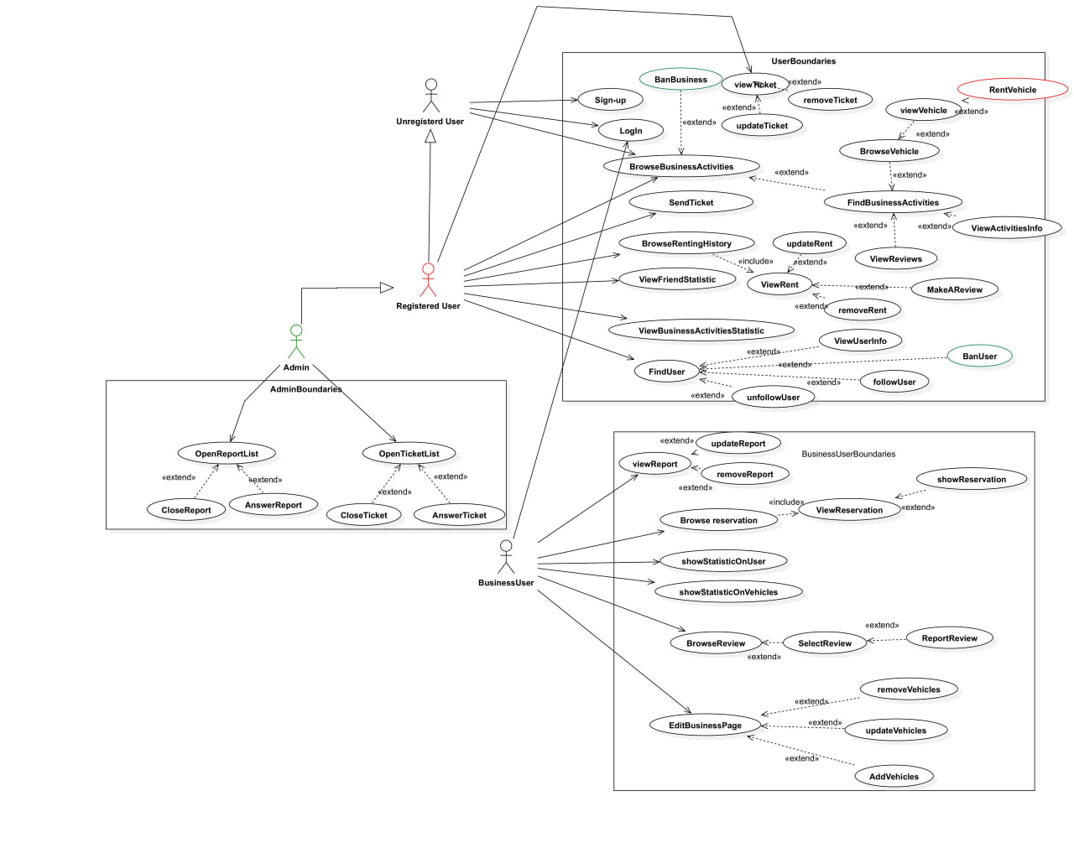
Actors and main supported functionalities
Notes:
FINITA

Slide 4
Dataset Description
Source:
https://www.kaggle.com/datasets/ankkur13/edmundsconsumer-car-ratings-and-reviews?select=Scraped_Car_Review_ferrari.csv
https://www.kaggle.com/datasets/zusmani/pakistan-car-reviews
https://randomuser.me/
Description:
Dataset containing different vehicles such as car and motorbike with reviews in JSON format. These reviews will be assigned to a random generated user with a random pattern (0 to 10 reviews each user)
Volume: 63Mb
Variety: Data are scraped using different sources such as Edmund and rentCars
Velocity/Variability: Our dataset doesn’t lose importance after time, so no refresh mechanism from the external world is taken in account. The dataset will be only modified from the interaction with the users through the application

Slide 5
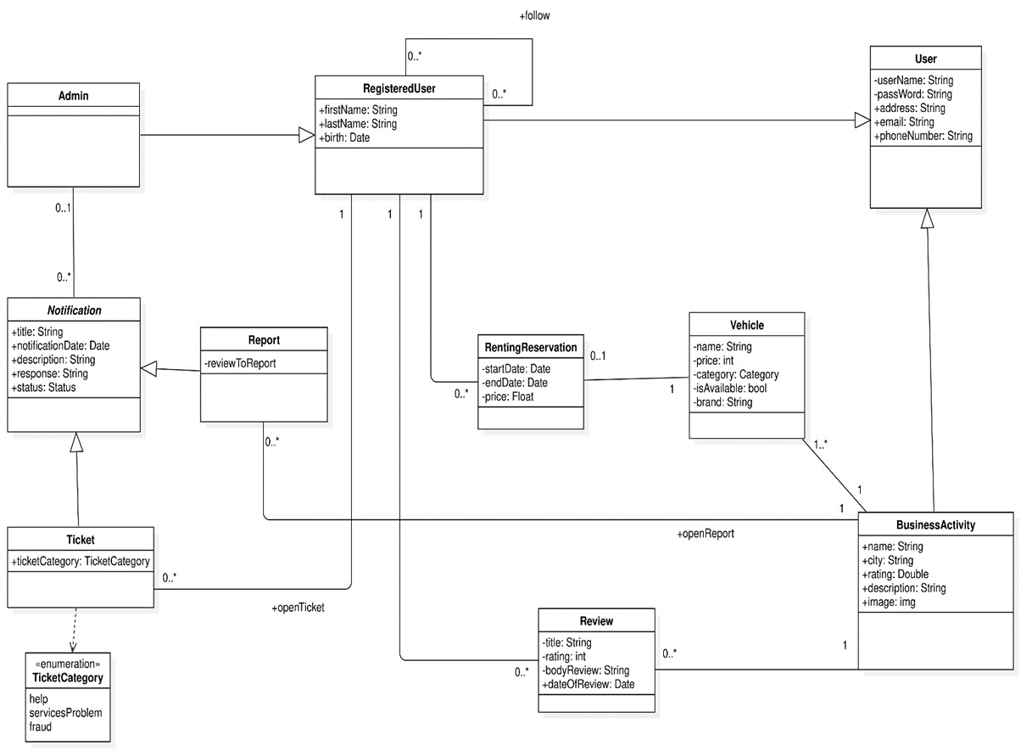
UML Class Diagram

Slide 6
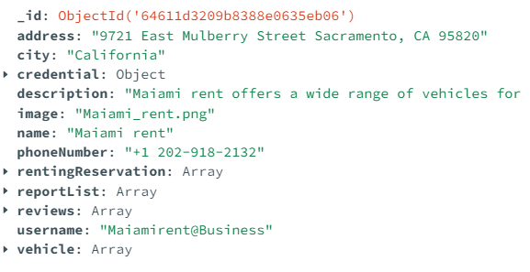
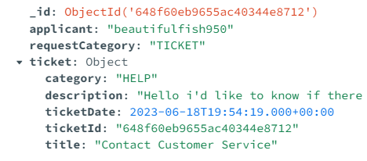
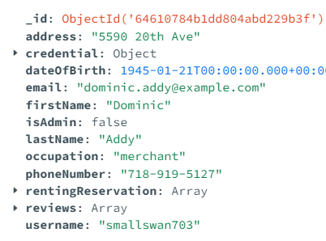
MongoDB design
BusinessActivity's collection
Open Notification's collection
User's collection

Slide 7
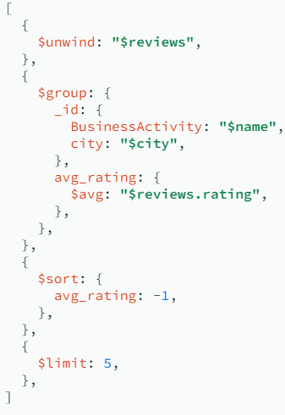
Relevant MongoDB queries
Analytics:
User side
-Top activities ranked by average rating for each city .
-Most rented vehicle brand for age of the user.
-Activity ranking by last year earnings for historic vehicles.
- Most used vehicle for user work typology.
- For each vehicle, total number of rentals in a range of N years
BusinessActivity side
Operations:
-AddReview
-AddReservation
-Delete Review/Reservation
-Modify Review/Reservation
-Get Reviews/Reservations/Reports/Ticket list

Slide 8
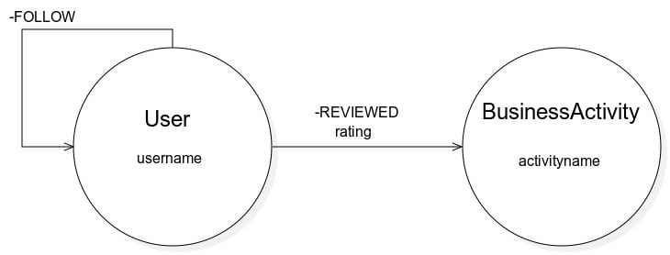
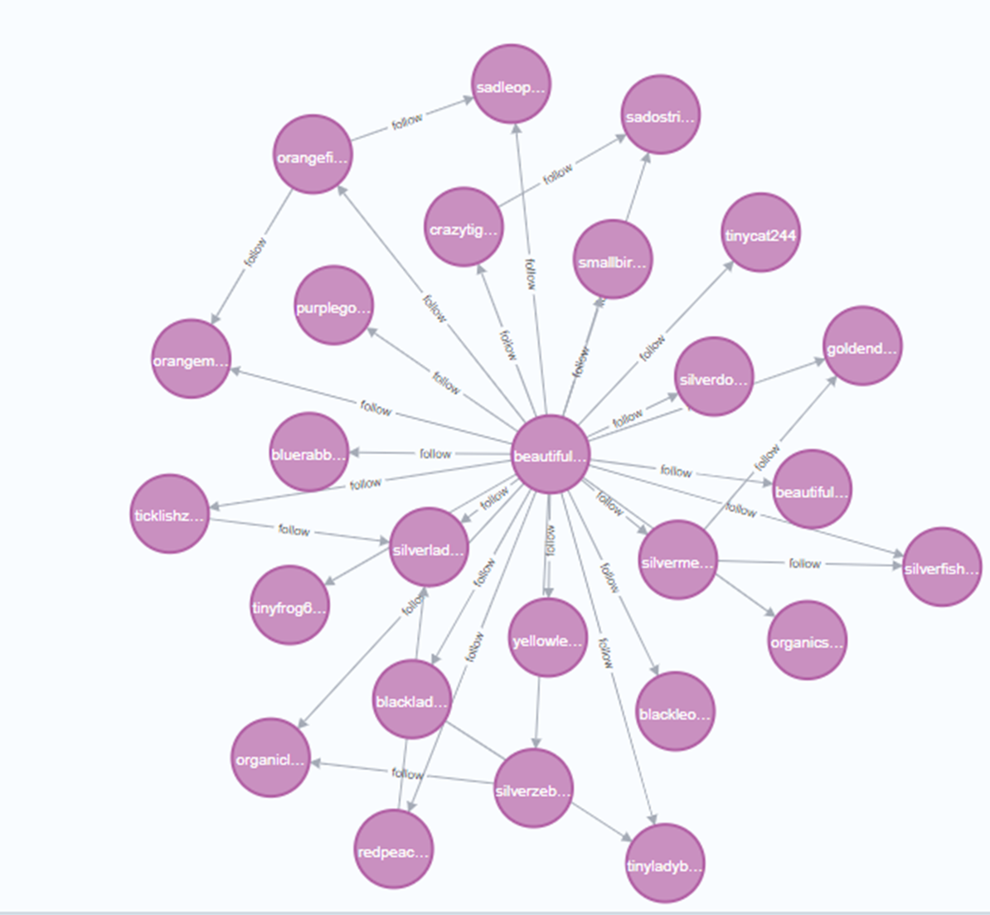
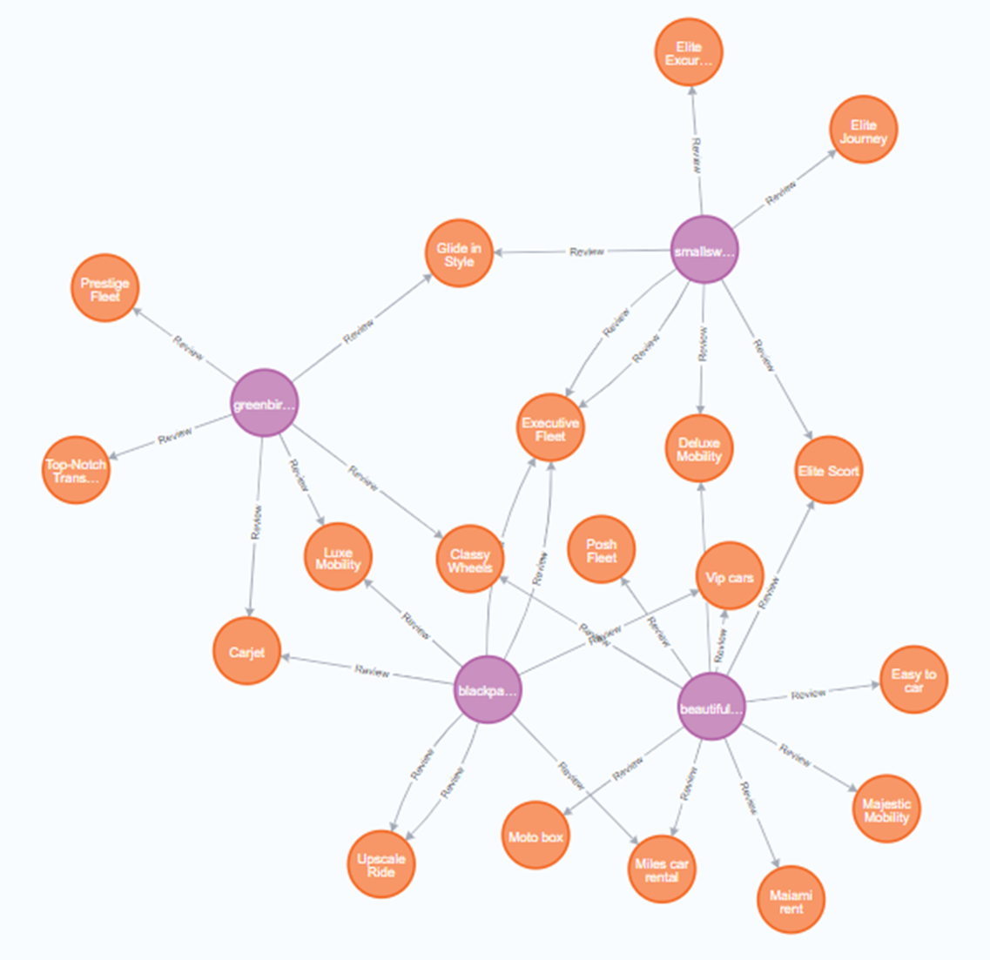
Neo4j design

Slide 9
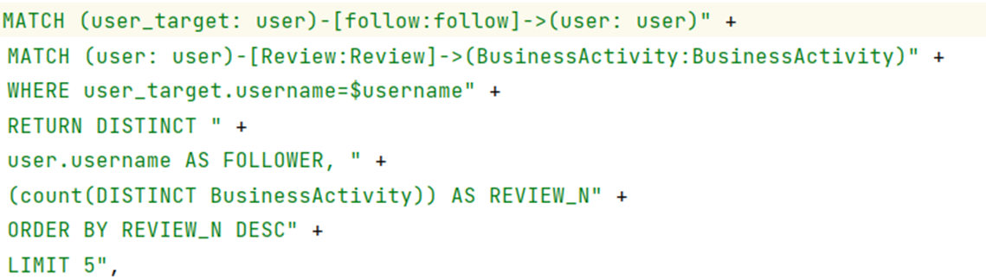
Relevant Neo4j queries
Analytics
Show recommended rental activity based on the rating of your followers
Most active users among followed ones
Most followed users among followed ones
Operations:
Follow User
UnfollowUser
AddReview
GetFollowerList
GetFollowedList

Slide 10
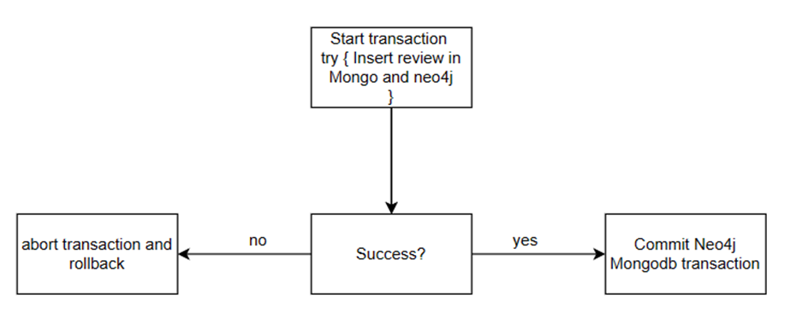
Consistency and Data Sharding Proposal
Sharding key:
• User Collection : Username
• BusinessActivity Collection : Name
• Open_Notification Collection: Applicant

Slide 11
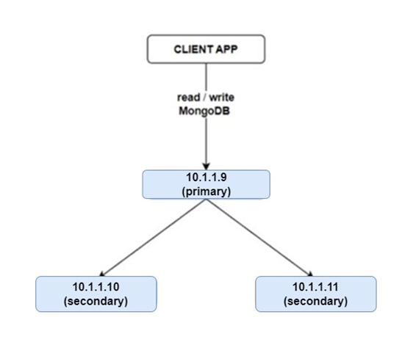

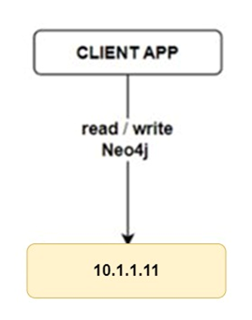
Software and Hardware Architecture
Next primary in case of crashes

